Slide 1

Introduction to TCP/IP I
7th edition
Jim Kurose, Keith Ross
Pearson/Addison Wesley
April 2016
- essentially adapted from Kurose and Ross
Introduction
1-<number>

Slide 2
Network overview
Introduction
1-<number>

Slide 3
















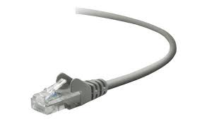



The Internet: a “nuts and bolts” view
Billions of connected computing devices:
  hosts = end systems
  running network apps
mobile network
national or global ISP
Packet switches: forward packets (chunks of data)
  routers, switches
local or regional ISP
Internet
Communication links
  fiber, copper, radio, satellite
  transmission rate: bandwidth
home network
content
provider
network
datacenter
network
Network
  collection of devices, routers, links: managed by an organization
enterprise
network
Introduction: 1-<number>
Notes:
Internet has three ingredients: (1) hosts; (2) packet switch; (3) communication links. The three components are grouped together into a Network such as campus network, home network.

Slide 4
The Internet: a “nuts and bolts” view
mobile network
Internet: “network of networks”
4G
national or global ISP
IP
Streaming
video
Skype
protocols are everywhere
  A language between two devices
  control sending, receiving of messages
  e.g., HTTP (Web), streaming video, Skype, TCP, IP, WiFi, 4G, Ethernet
local or regional ISP
home network
content
provider
network
HTTP
datacenter
network
Ethernet
TCP
enterprise
network
WiFi
Introduction: 1-<number>
Notes:
Different networks need to link together in order to communicate across different networks. Different devices have to use a common language in order to speak to each other. This common language is called a protocol. It describes what a device should do when receiving a message or command.

Slide 5
The Internet: a “services” view
provide services to applications:
  Web, streaming video, teleconferencing, email, games, e-commerce, social media, …
mobile network
national or global ISP
Streaming
video
Skype
local or regional ISP
provide socket programming interface
  Sender invokes this interface to send/receive message to/from a remote host
home network
content
provider
network
HTTP
datacenter
network
enterprise
network
Introduction: 1-<number>
Notes:
The internet can also be viewed in the service model: you use the internet by requesting a service from it. For programmers, it can use socket to take the services provided by Internet. Socket is an interface that allows to send or receive a message from remote host.

Slide 6













Access networks
Your connecting network
residential access nets
institutional access networks (school, company)
mobile access networks
Introduction
1-<number>
Notes:
The network you first connect is called access network. At home, home network is your access network; on campus, the campus network is your access network. Your mobile phone uses mobile network (from phone company).

Slide 7


Access network: digital subscriber line (DSL)
central office
telephone
network
DSL
modem
splitter
DSLAM
ISP
DSL access
multiplexer
  use existing telephone line to central office DSLAM
Introduction
1-<number>
Notes:
DSL network: message from your computer goes through DSL modem, transforming into a modulated signal (suitable for transmission), mixed with telephone signal by splitter. It is then sent to tel company DSL access multiplexer (DSLAM), which separates the telephone data and internet data, and then combines internet data from other households and send them to the internet.

Slide 8
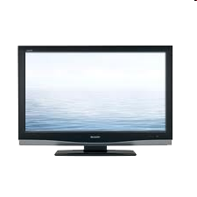


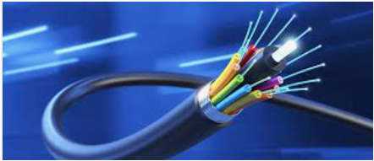
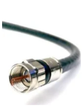
Access network: cable network
cable headend
…
cable
modem
splitter
CMTS
cable modem
termination system
ISP
Fiber cable
coaxial copper cable
network of cable, fiber attaches homes to ISP router
  homes share access network to cable headend
  unlike DSL, which has dedicated access to central office
Introduction
1-<number>
Notes:
Cable network is different from DSL in that the combined signal from splitter is sent to the cable company device CMTS using a single cable (usally fiber cable). This cable is shared with many households.

Slide 9







Access network: home network
wireless
devices
to/from headend or central office
often combined
in single box
cable or DSL modem
wireless access
point (54 Mbps)
router, firewall, NAT
wired Ethernet (1 Gbps)
Introduction
1-<number>
Notes:
This is a home network sample. The internet data arrives at your home. It first goes through the (cable or DSL) modem. This transforms into a low frequency signal. It then tries to reach a correct destination device. However, there are several internet devices. In this case, the router will determine which device is the correct recipient (if there is only one device, the router is not needed). The host device could connect to router by a twisted-pair copper wire. In this case, it communicates with router using Ethernet protocol. If your host device is wireless device, it can connect to the router through a wireless access point through WIFI. The protocol from your wireless device to wireless access point is 802.11 or its variants. Sometimes wireless access point, router or even modem are integrated into one device.

Slide 10








Wireless access networks
shared wireless access network connects end system to router
  via base station aka “access point”
wide-area wireless access
  provided by telco (cellular) operator, 10’s km
  between 1 and 10 Mbps
  3G, 4G: LTE
  5G
wireless LANs:
  within building (100 ft.)
  802.11b/g/n (WiFi): 11, 54, 450 Mbps transmission rate
to Internet
to Internet
Introduction
1-<number>

Slide 11
Internet protocol stack
Introduction
1-<number>

Slide 12
Network protocol
network protocols:
all communication activity in Internet governed by protocols
protocols define format, order of messages sent and received among network entities, and actions taken on message transmission, receipt
Can we use one protocol to implement the whole communication process to access www.uwindor.ca?
Introduction
1-<number>

Slide 13
Internet protocol stack
application: supporting network applications
  FTP, SMTP, HTTP
transport: process-process data transfer
  TCP, UDP
network: routing of datagrams from source to destination
  IP, routing protocols
link: data transfer between neighboring network elements
  Ethernet, 802.111 (WiFi), PPP
physical: bits “on the wire”
application
transport
network
link
physical
Introduction
1-<number>
Notes:
Internet is a complex system. It is very difficult for one application to implement the whole system. So it is decomposed into five layers and each layer is communicating with the neighboring layer through the service interface. Under this view, an internet application (such as a webserver) only needs to implement the server itself. The communication with the client can be done by sending the message to the transport layer. The network specifies the routing path to the destination. Link specifies the communication between each neighboring link. Physical layer handles the physical communication (turning the binary string into the physical signal).

Slide 14
Encapsulation
source
message
M
application
transport
network
link
physical
segment
H_{t}
M
H_{t}
datagram
H_{n}
H_{n}
H_{t}
M
frame
H_{l}
H_{n}
H_{t}
M
link
physical
switch
destination
H_{n}
H_{t}
M
network
link
physical
M
application
transport
network
link
physical
H_{l}
H_{n}
H_{t}
M
H_{n}
H_{t}
M
H_{t}
M
H_{n}
H_{t}
M
H_{l}
H_{n}
H_{t}
M
router
Introduction
1-<number>
Notes:
This gives an overall picture how each layer is providing service to the lower below. Specifically, at the sending side, when one layer receives the packet from the above layer, it adds one header. At the receiver side, the same layer will read this header and knows what to do.

Slide 15
HTTP
Application
transport
network
link
physical
Introduction
1-<number>

Slide 16
Web page
web page consists of base HTML-file, which will reference to several objects
object can be another HTML file, JPEG image, Java applet, audio file,…
each object is addressable by a URL, e.g.,
www.someschool.edu/someDept/pic.gif
host name
path name
/var/www/html/someDept/pic.gif
Application Layer
2-<number>
Notes:
Host name corresponds to the server’s network location (in terms of ip address; the details will be given later). The path name is the directory of the file on the server. /var/www/html is the default location on the server.

Slide 17
HTTP overview
HTTP: hypertext transfer protocol
Web’s application layer protocol
client/server model
  client: browser that requests, receives, (using HTTP protocol) and “displays” Web objects
  server: Web server sends (using HTTP protocol) objects in response to requests
HTTP request
PC running
Firefox browser
HTTP response
HTTP request
server
running
Apache Web
server
HTTP response
iPhone running
Safari browser
Application Layer
2-<number>

Slide 18
HTTP request message
two types of HTTP messages: request, response
HTTP request message:
  ASCII (human-readable format)
/var/www/html/index.html
carriage return character
request line
(GET, POST,
HEAD commands)
line-feed character
GET /index.html HTTP/1.1\r\n
Host: www.cs.umass.edu\r\n
User-Agent: Firefox/3.6.10\r\n
Accept: text/html,application/xhtml+xml\r\n
Accept-Language: en-us,en;q=0.5\r\n
Accept-Encoding: gzip,deflate\r\n
Accept-Charset: ISO-8859-1,utf-8;q=0.7\r\n
Keep-Alive: 115\r\n
Connection: keep-alive\r\n
\r\n
header
lines
carriage return,
line feed at start
of line indicates
end of header lines
Application Layer
2-<number>
Notes:
This is the http format, send/receive through TCP connection.

Slide 19
HTTP request message: general format
method
sp
URL
sp
version
cr
request
line
lf
header field name
value
cr
lf
~
~
header
lines
~
~
header field name
value
cr
lf
cr
lf
~
entity body
~
body
~
~
Application Layer
2-<number>

Slide 20
HTTP response message
status line
(protocol
status code
status phrase)
HTTP/1.1 200 OK\r\n
Date: Sun, 26 Sep 2010 20:09:20 GMT\r\n
Server: Apache/2.0.52 (CentOS)\r\n
Last-Modified: Tue, 30 Oct 2007 17:00:02 GMT\r\n
ETag: "17dc6-a5c-bf716880"\r\n
Accept-Ranges: bytes\r\n
Content-Length: 2652\r\n
Keep-Alive: timeout=10, max=100\r\n
Connection: Keep-Alive\r\n
Content-Type: text/html; charset=ISO-8859-1\r\n
\r\n
data data data data data ...
header
lines
data, e.g.,
requested
HTML file
Application Layer
2-<number>

Slide 21
HTTP response status codes
status code appears in 1st line in server-to-client response message.
some sample codes:
200 OK
  request succeeded, requested object later in this msg
301 Moved Permanently
  requested object moved, new location specified later in this msg (Location:)
400 Bad Request
  request msg not understood by server
404 Not Found
  requested document not found on this server
505 HTTP Version Not Supported
Application Layer
2-<number>

Slide 22
DNS: domain name system
people: many identifiers:
  SSN, name, passport #
Internet hosts, routers:
  IP address (32 bit) - used for addressing datagrams
  “name”, e.g., www.yahoo.com - used by humans
The need to translate host name to ip address.
Domain Name System:
name server
  Resolve the name to ip address translation
DNS is an application-layer protocol:
  executed between host (your computer) and name servers to resolve names/ipaddress translation
  Your host starts the DNS query at local DNS server.
  one DNS server in the world: a single point of failure problem
Application Layer
2-<number>
Notes:
When you visit www.google.com, you browser needs to first translate www.google.com into its ip address. This is done by DNS protocol. DNS is an application layer protocol.

Slide 23
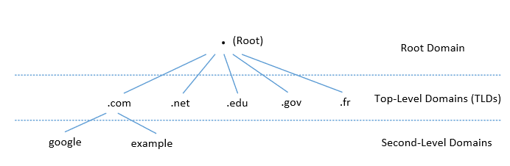
DNS Domain Hierarchy
The root of the domain is called ROOT, denoted as ‘ . ‘.
Below ROOT, we have Top-Level Domain (TLD).
Ex: In www.example.com, the TLD is .com.
The next level of domain hierarchy is second-level domain which are usually assigned to specific entities such as uwindsor.ca
Notes:
DNS is organized in the hierarchical structure. This is for the efficiency of the DNS system.

Slide 24
Authoritative Name Servers
Hostname has an authoritative nameserver. This is the DNS server that certainly can provide the answer to a DNS query on this hostname.
Ex. our uwindsor DNS server is the authoritative DNS server for www.uwindsor.ca
Notes:
In one sentence, the authoritative name server of a zone is the DNS server that maintains the DNS records for this zone. It has the master (primary) and the secondary. The secondary works as the backup for the master (to share the workload of the master).

Slide 25
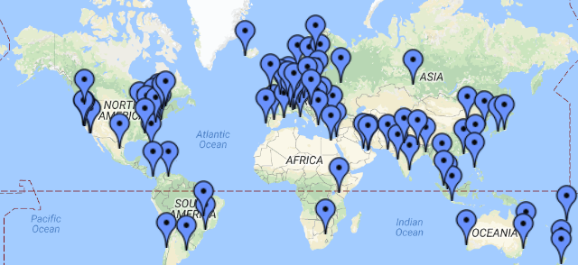
DNS ROOT Servers
The root zone is called ROOT.
There are 13 root DNS servers.
They provide the nameserver information about all TLDs
        https://www.internic.net/domain/root.zone
They are the starting point of DNS queries.

Slide 26
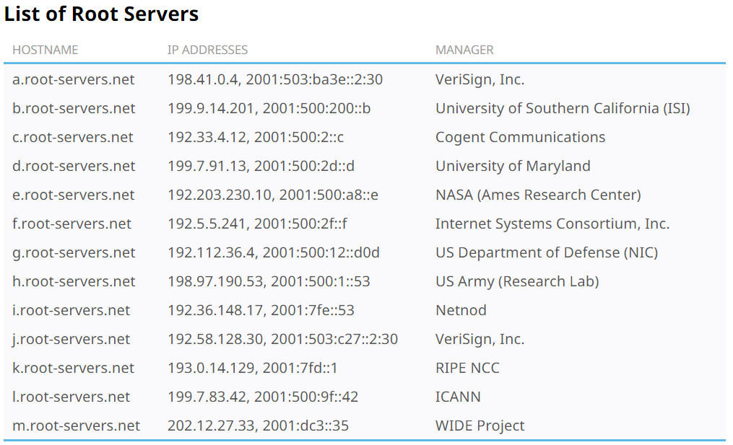
13 DNS Root Servers
Note: each root DNS such a.root-servers.net has many identical servers worldwide.
Notes:
As of now, there are over 1,600 physical root server instances globally, even though they are grouped under just 13 names.

Slide 27
Top Level Domain (TLD)
Infrastructure TLD: .arpa
Generic TLD: .com, .net,
Sponsored TLD: .edu, .gov, .mil, .travel, .jobs
Country TLD: .au (Australia), .cn (China), .fr (France)
Reserved TLD: .example, .test, .localhost, .invalid

Slide 28
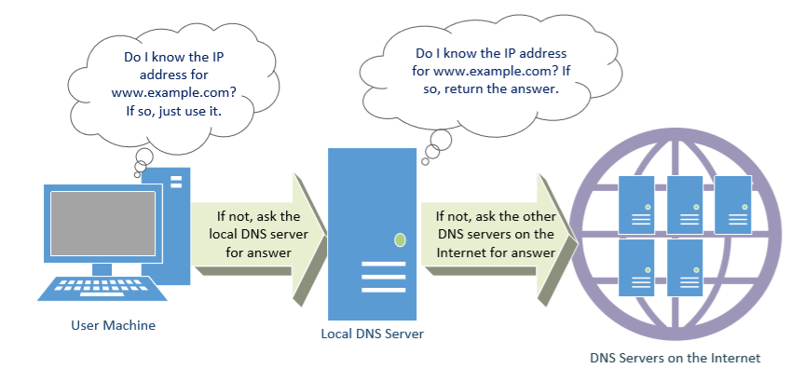
DNS Query Process

Slide 29
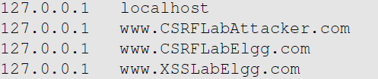
Local DNS Files
/etc/hosts: stores IP addresses for some hostnames. Before machine contacts the local DNS servers, it first looks into this file for the IP address.
Notes:
Before your computer sends the DNS query to the local DNS server, it will consult /etc/hosts file first. You can provide your IP address mapping into /etc/hosts. This might be useful when you are test some pages. But it should be pointed out that firefox will not check this file and directly sends dns query to the local DNS server. The DNS server is shown in /etc/resolv.conf. Normally, it is provided by DHCP protocol when you obtain the IP address for your computer.

Slide 30
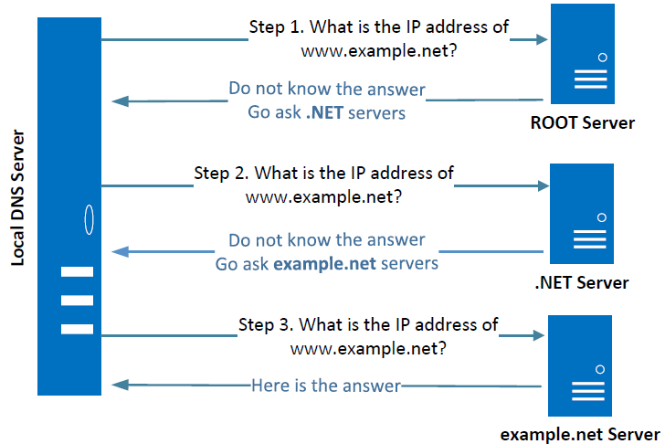
Iterative DNS Query Process
Query starts from the ROOT Server. If it doesn’t know the IP address, it sends back the IP address of the .NET nameservers
.Net does the similar action.
…..
Finally, the last level server (authoritative DNS server) provides the answer.
Notes:
The Local DNS servers need not be local. They may or may not be set up in the local network. Google Public DNS is a DNS service offered by Google, serving any host on the Internet.

